Slide 1
Basic Particle Animation Systems
A quick introduction by Mike Randrup (UI Engineer Mobile Web)

Slide 2
Basic Particle Recipe
A set of particles
Operated on (animated) over time
Drawn to display somehow

Slide 3
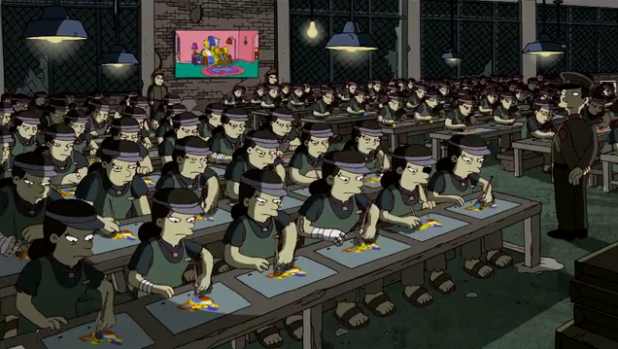

How Kim Jong-un Animates Particles.

Slide 4
Some Decisions
Particles from image
Tween from random position to image position
Animation based on update time

Slide 5
The Particle Structure
{ color
native X & Y
alternate X & Y
current X & Y personality
}

Slide 6
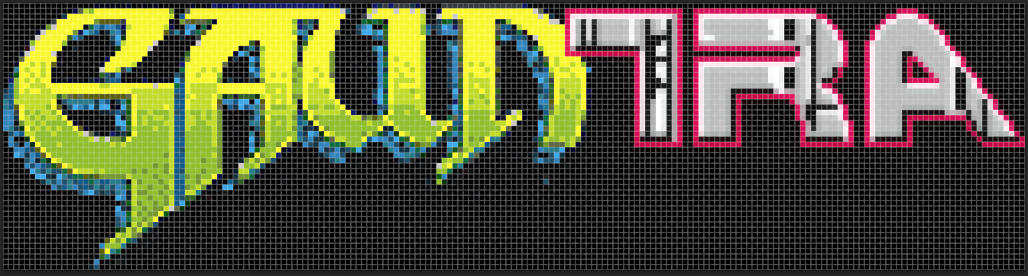
Initializing the Particles
It’s an array … of particles.
Assign particle values (from an image in this case)
Color
Position

Slide 7
Update particle values
Know what time it is
Tween the animation
Record the result

Slide 8
Draw to Display (HTML5 Canvas)
canvasElement = document.getElementById("titleparticles");
canvasContext = canvasElement.getContext('2d');
canvasContext.fillStyle = backgroundColor; //hex, rgba, etc)
canvasContext.fillRect(startX,startY,width,height);

Slide 9
More Complex Animation
Multiple Animation Modes
Combine with other Graphical Elements

Slide 10

The Gauntra Project
Pixelated Retro Graphics theme
Lasers & Axes

Slide 11
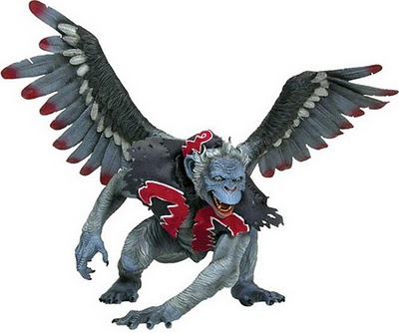
Go forth, & summon an army!
View source on MikeRandrup.com/dev/2012/gauntra
Will post to GitHub soon.

